Slide 1


Hope to Skills
Lecture# 18
Irfan Malik, Dr. Sheraz Naseer

Slide 2
Agenda
Classification Techniques
Sci-kit Learn

Slide 3
Different Classification Techniques

Slide 4
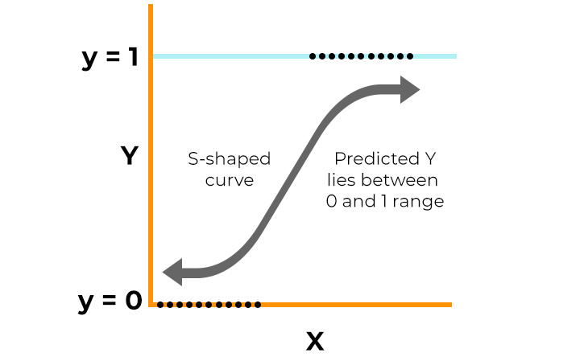
Logistic Regression
Logistic regression is a technique used to predict the probability of something happening or not happening. It's like drawing a line to separate things into two groups based on certain characteristics.

Slide 5
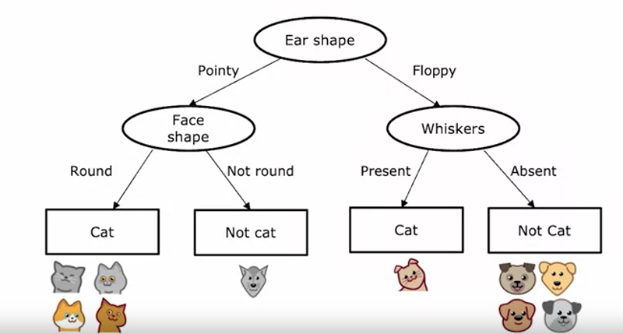
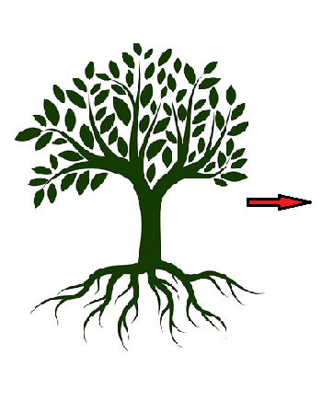
Decision Tree Classifier
A decision tree classifier makes decisions by splitting the data into smaller subsets based on the values of input features, ultimately assigning a class label to each data point. It constructs a tree-like structure of decision rules that can be used for prediction and is easy to interpret.

Slide 6
Ensemble:
Ensemble learning is a machine learning technique that combines the predictions of multiple individual models (learners) to improve overall performance and generalization. Instead of relying on a single model, ensemble methods create a "committee" of models and aggregate their predictions to make a final decision.

Slide 7
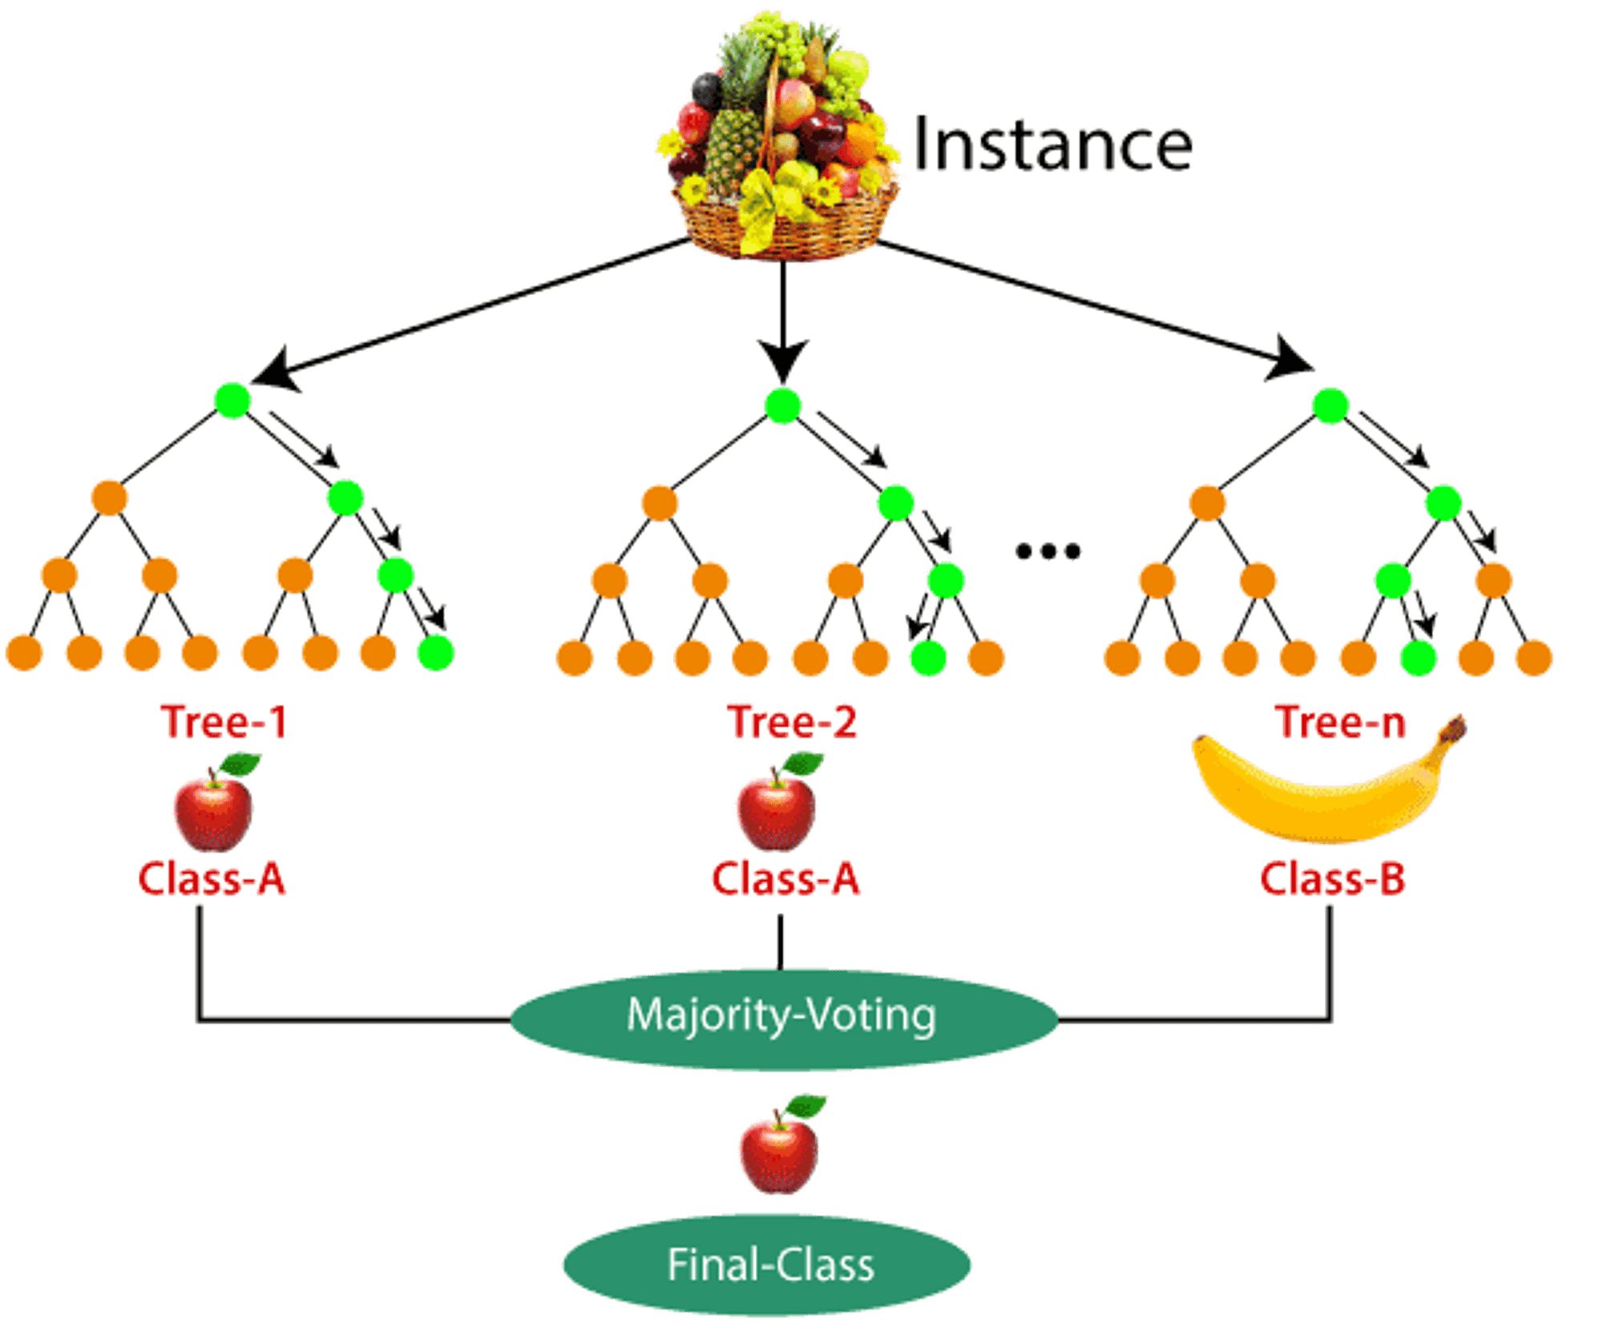
Random Forest Classifier
Random Forest is ensemble learning method that creates multiple decision trees during training and outputs the majority vote from all individual trees.

Slide 8
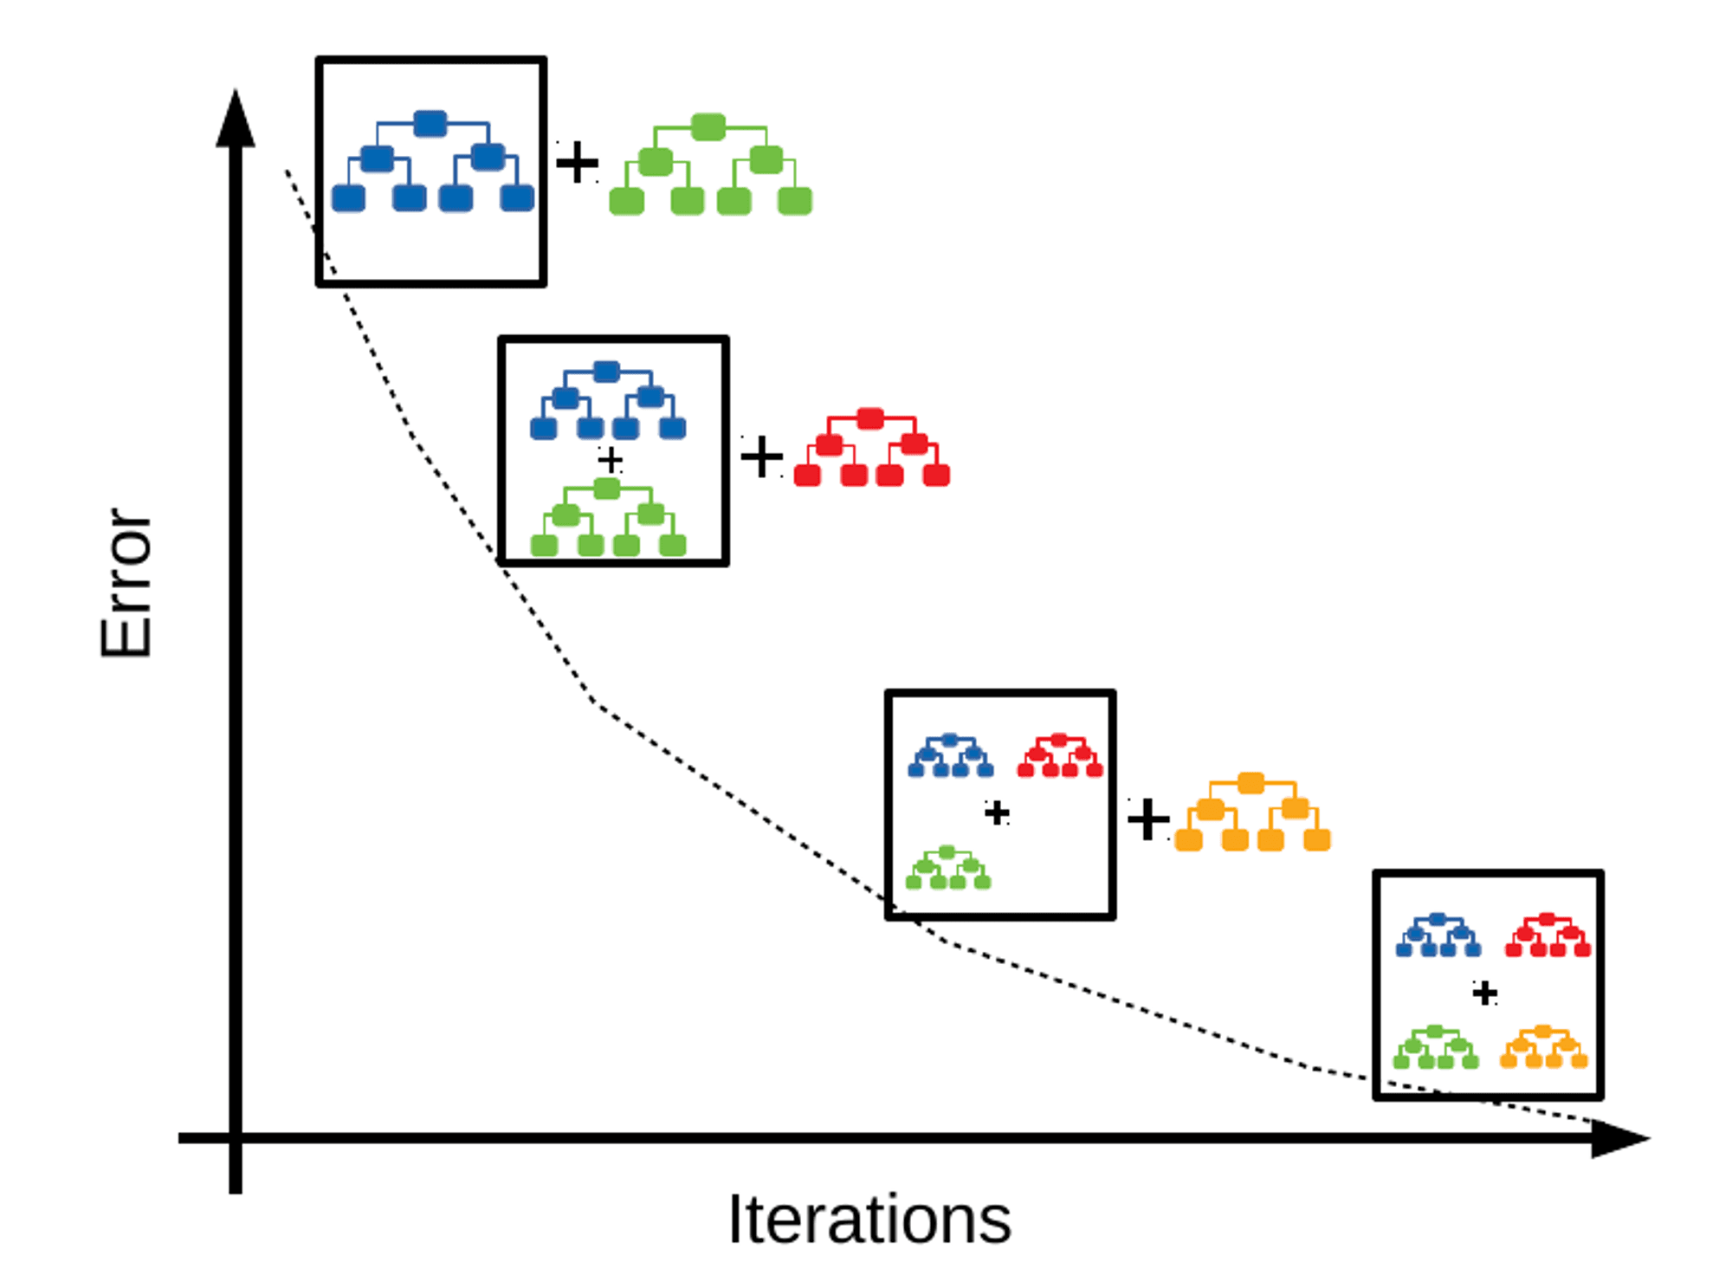
Gradient Boosting Classifier
Gradient Boosting Classifier is a powerful ensemble learning technique used for classification tasks. It belongs to the class of boosting algorithms, which build a strong predictive model by combining multiple weak learners sequentially.

Slide 9
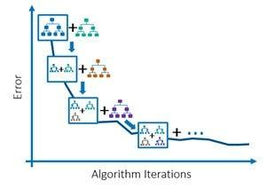
Gradient Boosting classifier
Gradient Boosting is ensemble learning technique that builds multiple decision trees sequentially, each one correcting the errors of its predecessor.

Slide 10

Accuracy
It is the ratio of number of correct predictions to the total number of input samples.
Note:It works well only if there are equal number of samples belonging to each class.

